Slide 1
Genesis
Covenant-making and temple creating

Slide 2
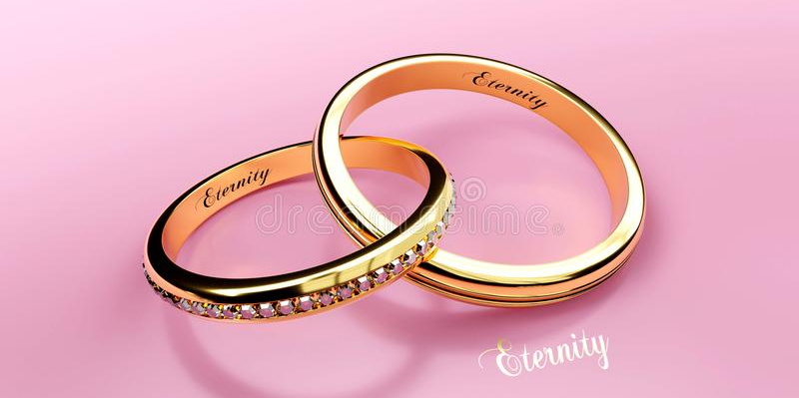
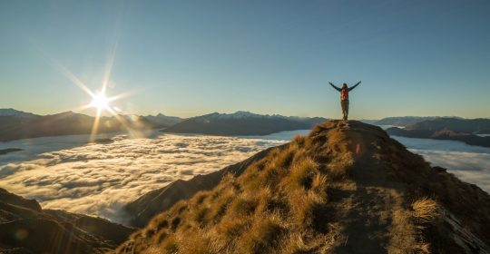
Covenant Essentials:
1. People (to make a covenant with)
2. A mediator
3. A mountaintop

Slide 3
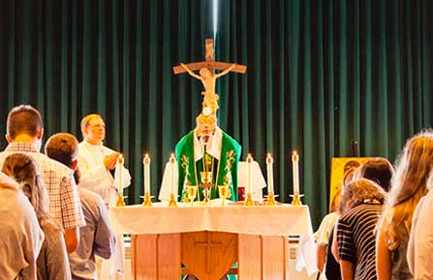
“Covenant”
Where do we hear the word ‘covenant’ every week?
At Mass:
1. “Time and time again you offered [humanity] covenants and through the prophets taught them to look forward to salvation.”
2. “This is the chalice of my Blood, the blood of the new and eternal covenant.”

Slide 4
‘Contract’ vs. ‘Covenant’
Two parties agree to do something
If one party violates the agreement then the contract is broken
The signers of the contract agree to uphold their ends as long as the other signer does
Two parties agree to do something
They promise to uphold each of their ends of the promise regardless of whether the other party keeps their part of the agreement
If a member violates the covenant, the other party still agrees what they said they would do
Notes:
We naturally filter everything we understand about God in terms of a contract. We assume that if we don’t hold up our end then, contractually, God won’t hold up his. As a result we find it impossible to approach a Holy God because we know we can never hold up our end of the bargain. The standard is perfection and we know we’re not perfect.

Slide 5
Covenant:
“ a legal way to make someone a part of your family”

Slide 6
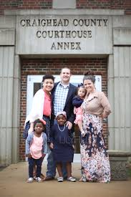
Adoption
In the Ancient world, you would take the child unrelated to you whom you intended to adopt before priest, village elders, or some official
Then you would swear solemn oaths that the child was now yours
Then you went home with a new son or daughter

Slide 7
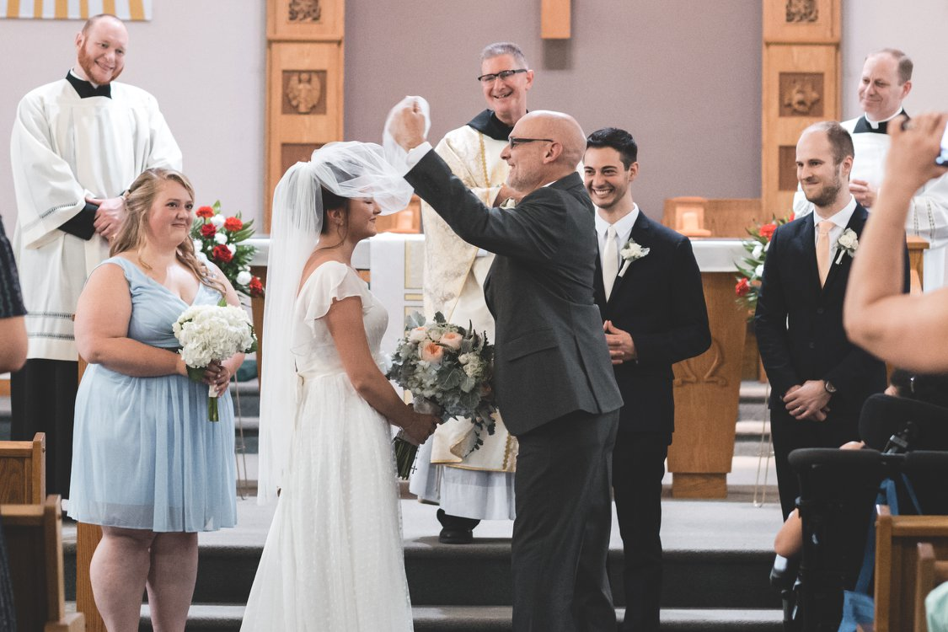
Marriage
Two people stand before a priest, minister, or judge and swear solemn oaths to each other
Two people enter the building with two different names and leave as husband and wife
Two “strangers” have become family by making a covenant

Slide 8
God’s idea of a covenant:
When the priest says “time and time again you offered them covenants” it means “God has repeatedly tried to make us his family”

Slide 9
In our world…
Marriage isn’t as popular as it used to be
Many people don’t get married or they put it off for a long time
They don’t see it as a good thing or see it as a casual relationship
Many relationships are just for hooking up or staying around until things get difficult
Why?
Many people fear… COMMITMENT
Notes:
COMMITMENT
Unity – being on the same page
Friendship
Understanding
Unconditional love

Slide 10
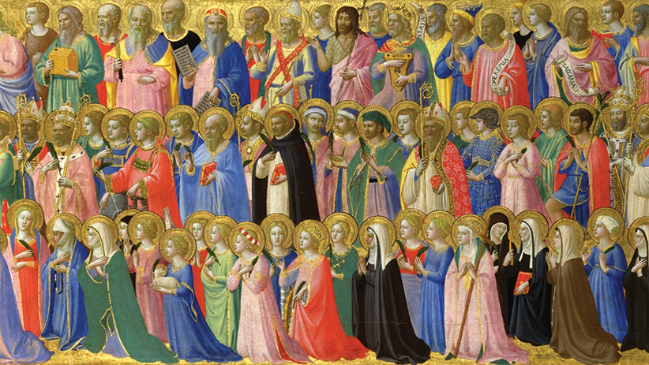
In God’s world…
He believes strongly and entirely in marriage and family
This is the relationship he seeks with all of us
He seeks it with each one of us personally
It’s not some casual or an easily broken friendship or dating relationship

Slide 11
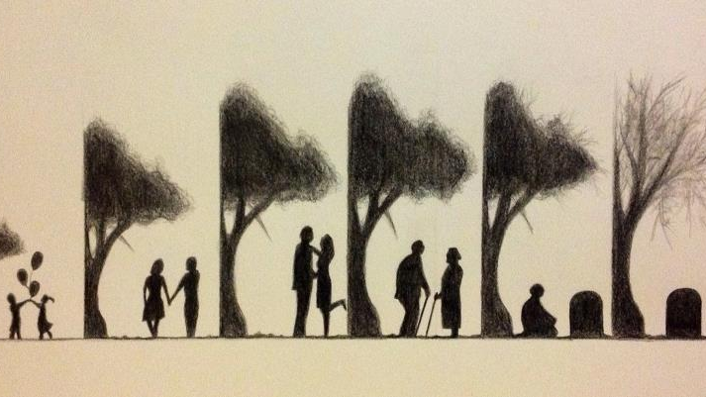
What God wants
The covenant shows that what God wants with us is really a marriage relationship – chocolate and flowers, big diamond ring, ‘till death do us part,’ etc.
God is all about COMMITMENT and love that lasts “till death do us part” and beyond because not even death parts us from God
This is all summed up in the word ‘covenant’

Slide 12
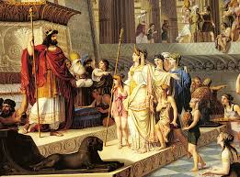
Mediators
In ancient times, many people wanted to involve more than just two people in the covenant
Example: a king wanted to let a group of foreigners into his family (or kingdom) so he would make a covenant with them
Usually one person would step forward to represent the group of people whom the covenant was being made with
This person was called the ‘mediator’

Slide 13
Covenant Mediators
Persons who represent groups of people involved in a covenant
Our covenant mediators:
Adam
Noah
Abraham
Moses
David
Jesus
Each of them entered into a covenant with God and represented a group of people

Slide 14
Mountains – why do they matter?
Every covenant is made on top of a mountain
This can’t be an accident – somehow they’re suitable to God
Mountains make you feel closer to God
Lonely, quiet – not a lot of people and business going on
Easier to focus on basic reality – yourself and God
Gives you a “God’s-eye” view of things – the farm you live on might seem enormous in the valley but from a mountaintop it’s the size of a postage stamp, now you can see dozens or hundreds of farms stretching out
You can see a bigger pattern you couldn’t see before

Slide 15
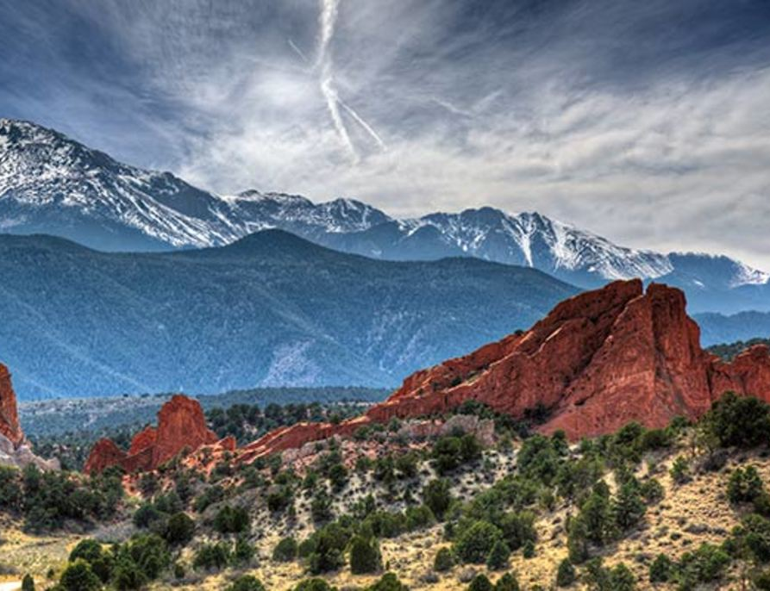
Why Mountains?
You are more or less alone with God
You can see much more
It all looks smaller
You can see everything in context – together with all its surroundings

Slide 16
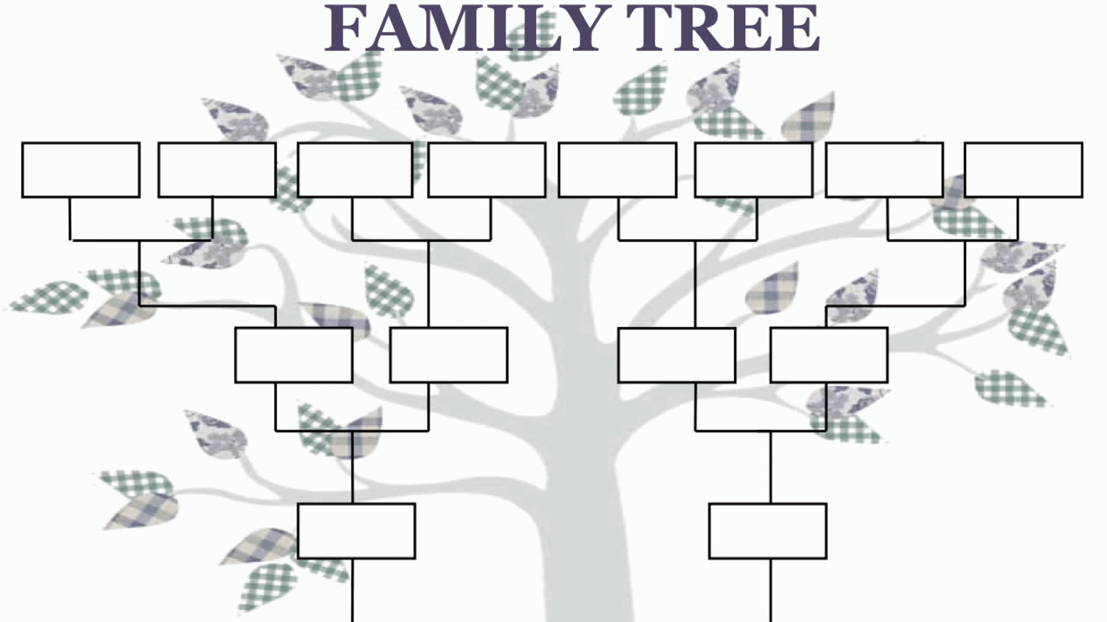
We question ourselves…
What is the meaning of life?
Why are we here?
All relates back to – “Where did I come from?”
Think about people’s fascinations with genealogies
Knowing where we came from helps us figure out where we ought to go
knowing one’s ancestors gives meaning to one’s life here and now
Adam and Eve – our first Father and Mother – the purpose of their lives is the purpose of our lives today

Slide 17
What Genesis isn’t trying to answer
Are the six days of creation literal?
Is the earth really so young?
Where does this story fall next to the Big Bang theory and evolution?
What is important for the author is
why God created the world?
Notes:
The author is trying to teach us the purpose for God creating the world

Slide 18
Background: Building a Temple
“In the beginning, when God created the heavens and the earth and the earth was without form or shape, with darkness over the abyss and a mighty wind sweeping over the waters” (Gen. 1:1 & 2)
What we see is a world (or universe) that exists, but is not finished yet
It has two problems. It is:
1. Formless – tohu
2. Void – wabohu
The phrase tohu wabohu describes a situation of chaos
So…if the world is unformed and empty – it needs to be formed and filled
Notes:
Gen. 1:1 – in the beginning God created the heavens and the earth”

Slide 19
3 | 6
2 | 5
1 | 4
Formless (Tohu)
Void (Wabohu)

Slide 20
Day 1: Light (Day) & Darkness (Night)
God begins to form and shape creation
Genesis 1:3-5
Then God said: Let there be light, and there was light. God saw that the light was good. God then separated the light from the darkness. God called the light “day,” and the darkness he called “night.” Evening came, and morning followed—the first day.
TIME

Slide 21
Day 2: Space, Skies, Seas
Genesis 1:6-8
Then God said: Let there be a dome in the middle of the waters, to separate one body of water from the other. God made the dome, and it separated the water below the dome from the water above the dome. And so it happened. God called the dome “sky.” Evening came, and morning followed—the second day.
Space

Slide 22
Day 3: Dry Land & Vegetation
Genesis 1:9-13
Then God said: Let the earth bring forth vegetation: every kind of plant that bears seed and every kind of fruit tree on earth that bears fruit with its seed in it. And so it happened: the earth brought forth vegetation: every kind of plant that bears seed and every kind of fruit tree that bears fruit with its seed in it. God saw that it was good. Evening came, and morning followed—the third day.
Habitat
Notes:
Eventually will provide a home for animals and humans
At this point God has solved the problem of formless but the cosmos remains bohu or empty
The next three days God fills the emptiness

Slide 23
Day 4: sun, moon, and stars
Genesis 1:14-19
Let them mark the seasons, the days and the years, and serve as lights in the dome of the sky, to illuminate the earth.
Mo’ed (Hebrew) = liturgical seasons
Time is now inhabited
Notes:
The realm of time is filled with inhabitants – sun, moon, and stars
These mark the passage of time and indicate the ‘seasons’ which the word for in Hebrew is ‘mo’ed’ = Moe-AID = liturgical seasons
In other words, sun moon and stars mark the passage of time so people know when to worship/go to Mass
Time is now inhabited
Let there be lights in the dome of the sky, to separate day from night. Let them mark the seasons, the days and the years,^{g}15and serve as lights in the dome of the sky, to illuminate the earth. And so it happened:16God made the two great lights, the greater one to govern the day, and the lesser one to govern the night, and the stars.^{h}17God set them in the dome of the sky, to illuminate the earth,18to govern the day and the night, and to separate the light from the darkness. God saw that it was good.19Evening came, and morning followed—the fourth day.

Slide 24
Day 5: birds & fish
Genesis 1:20-22
Let the water teem with an abundance of living creatures, and on the earth let birds fly beneath the dome of the sky. God created the great sea monsters and all kinds of crawling living creatures with which the water teems, and all kinds of winged birds. God saw that it was good, and God blessed them, saying: Be fertile, multiply, and fill the water of the seas; and let the birds multiply on the earth
The spaces are filled
Notes:
Fills the spaces with birds and fish

Slide 25
Day 6: animals & man (Adam)
Genesis 1:24-31
God made every kind of wild animal, every kind of tame animal, and every kind of thing that crawls on the ground. God saw that it was good. Then God said: Let us make human beings in our image, after our likeness.
The Habitat is filled

Slide 26
Day 7: The Sabbath Rest & Worship
Notes:
Now we need a roof on top of the whole building – the sabbath day of rest and worship

Slide 27
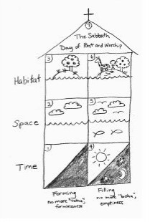

Slide 28
How do we know it’s a temple?
The language used to tell the creation story resembles the language that Moses used when talking about building the Tabernacle in the wilderness.
Some psalms speak of the creation as a temple (Ps 78:69, Ps 148)
He built his shrine like the heavens, like the earth which he founded forever
At the same time Genesis was written, other writings showed that people considered the whole universe to be a kind of temple for worshipping God (or gods)

Slide 29
The Garden of Eden as a Temple
- the original “sanctuary”
- the model for all future temples
- Genesis 2:11-12
- “…where there is gold. The gold of the land is good;…”
- Temples in the ancient world decorated with gold and precious stones
- temples throughout the ancient world were built and decorated to look like the original divine garden

