Slide 1
The Five Roles of Adam

Slide 2
The Creation of Adam
“The LORD God formed the man out of the dust of the ground and blew into his nostrils the breath of life, and the man became a living being.”
~ Genesis 2:7

Slide 3
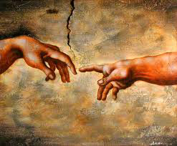
What was the purpose of Adam’s life?
First thing we know about Adam:
He was created in the “image and likeness of God”
What does it mean to be created in the image and likeness of God?

Slide 4
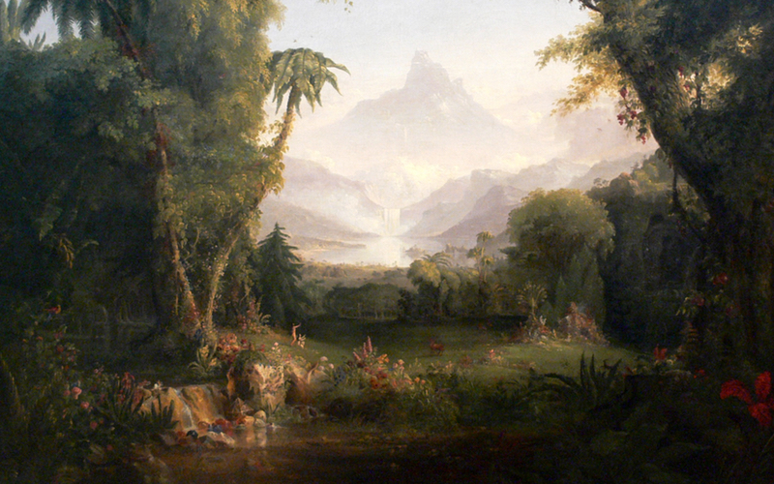
Created in the “image and likeness of God”
Genesis 5:3 – “When Adam had lived a hundred and thirty years, he became the father of a son in his own likeness after his image, and named him Seth.”
Image & Likeness = to be a son or daughter, a child of God
Divine Filiation – being a child of God

Slide 5
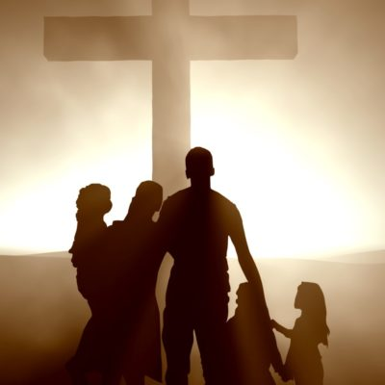
God’s image
We’re an extension of God – think of your relationship with your parents – you are an extension of your parents in the world
We are images of God in world
We are God’s family (or relatives) in the world

Slide 6
Image and Likeness of God
“Man is made to live in communion with God in whom he finds happiness: “When I am completely united to you, there will be no more sorrows or trials; entirely full of you, my life will be complete”” (St. Augustine, Confessions) (CCC 45)

Slide 7
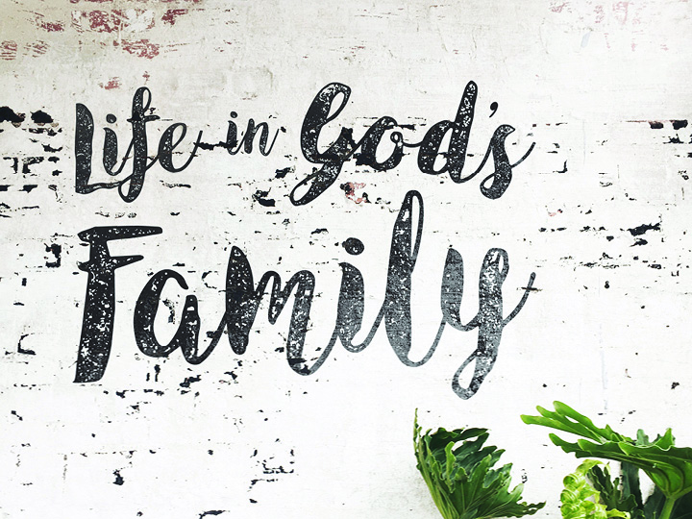
Role #1: Son of God
Citation: Luke 3:38 – “the son of Enos, the son of Seth, the son of Adam, the son of God.”
Stick figure:
Smile: because he is the Son of God
Face shining (lines coming out of head): because he is shining with God’s glory from being a son of God

Slide 8
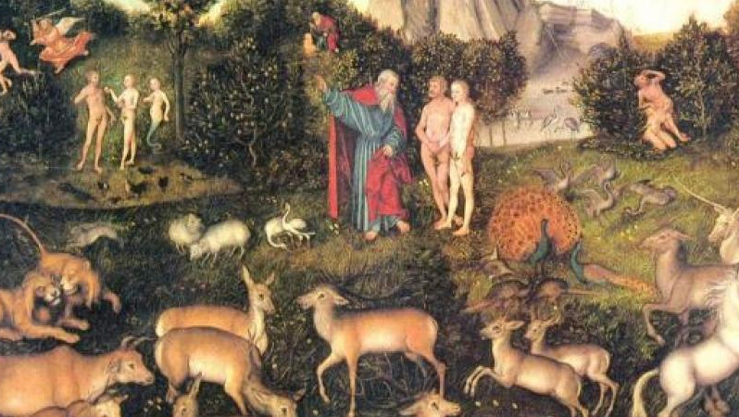
Role #2: Priest
“The LORD God planted a garden in Eden, in the east, and placed there the man whom he had formed…The LORD God then took the man and settled him in the garden of Eden, to cultivate and care for it. The LORD God gave the man this order: You are free to eat from any of the trees of the garden except the tree of knowledge of good and evil. From that tree you shall not eat; when you eat from it you shall die.” ~ Genesis 2

Slide 9
Adam as Priest
God places Adam in the Garden he has made “to till and keep it” (or cultivate and care for it)
wordplay going on:
In Hebrew “to till and keep” = to serve (it) and guard (it)
‘serve’ and ‘guard’ are two uncommon verbs to find together in the Bible
The next time we find them together is in Numbers 3:7-8, describing what the priests do in the place of worship

Slide 10
Adam as Priest
Those in that time familiar with the Scriptures, would have known that it was a priestly duty that was given to Adam
So, these readers would have seen Eden as a temple
Later on, temples would be decorated to look like gardens – stars, clouds, suns and moons on the ceilings
So, Adam had a priestly role in Eden, the original temple, which he served and guarded
Stick figure: Adam now has a stole around his neck

Slide 11
Role #3: King
Genesis 1:26 & 28:
Then God said: Let us make human beings in our image, after our likeness. Let them have dominion over the fish of the sea, the birds of the air, the tame animals, all the wild animals, and all the creatures that crawl on the earth.
God blessed them and God said to them: Be fertile and multiply; fill the earth and subdue it. Have dominion over the fish of the sea, the birds of the air, and all the living things that crawl on the earth

Slide 12
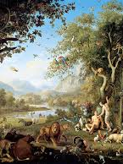
Adam as King
Dominion = means that Adam had a kingly role
Adam was a king of all of the living things on earth
Stick figure: Adam now has a crown

Slide 13
Role #4: Prophet
Genesis 2:18-20
The LORD God said: It is not good for the man to be alone. I will make a helper suited to him. So the LORD God formed out of the ground all the wild animals and all the birds of the air, and he brought them to the man to see what he would call them; whatever the man called each living creature was then its name. The man gave names to all the tame animals, all the birds of the air, and all the wild animals; but none proved to be a helper suited to the man.

Slide 14
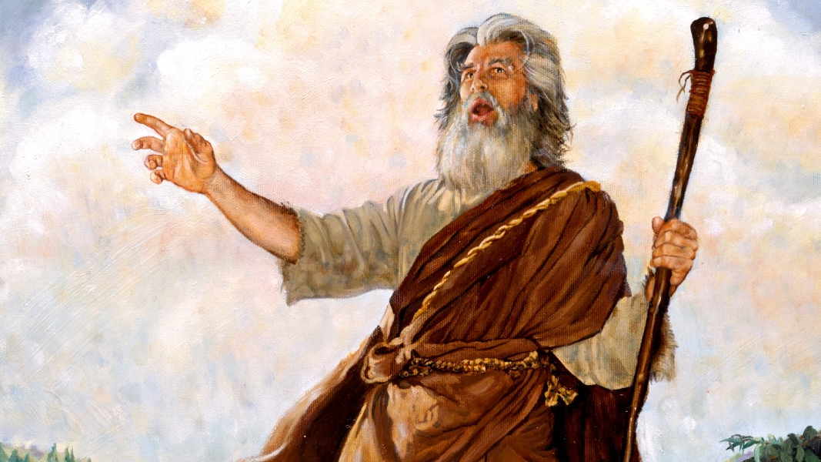
Adam as Prophet
In ancient times, giving a name was a very important privilege
Only the Creator of something can name something
Example: naming a child writing a song, molding a sculpture – you have the right to name it
God is making Adam his ‘deputy’, a divine privilege – the right to name God’s creatures
Adam gets to speak on behalf of God
Someone speaking on behalf of God = a prophet

Slide 15
Role #5: Husband/Bridegroom
There is ‘no helper fit for Adam’ among the animals
God puts him in a deep sleep and makes the woman for him out of his rib
Eve is brought to Adam, leading Adam to proclaim:
“Bone of my bone,
and flesh of my flesh,
she shall be called woman,
because she was taken out of man.”

Slide 16
Adam as Husband/Bridegroom
This is the first poetry found in the Bible
Before this Adam has simply been naming animals
Most likely just saying, “dog”, “ape”, “bird”
But perhaps now the author is trying to say that the arrival of woman is a high point in God’s creation as she was created last
She brings out the best in man

Slide 17
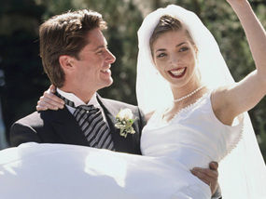
Covenant-Making
“Bone of my bone…” is covenant-making language
Adam is declaring Eve to be part of his family
Remember, this is what you do in a covenant
An unrelated man and woman go into a church or courtroom and come out as family
This is the first wedding, the first bride and groom in history with God as the officiant
So, Adam’s last role is Bridegroom

Slide 18
Why do we care about Adam’s roles?

Slide 19
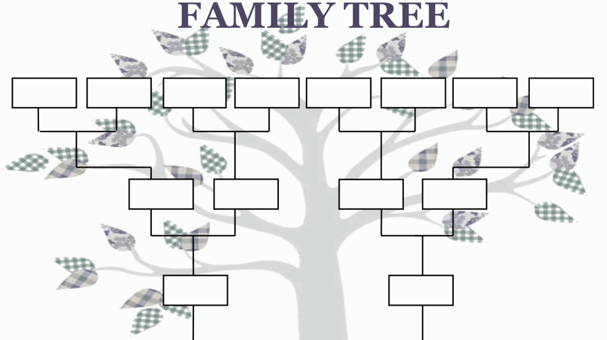
We question ourselves…
What is the meaning of life?
Why are we here?
All relates back to – “Where did I come from?”
Think about people’s fascinations with genealogies
Knowing where we came from helps us figure out where we ought to go
knowing one’s ancestors gives meaning to one’s life here and now
Adam and Eve – our first Father and Mother – the purpose of their lives is the purpose of our lives today

Slide 20
What is the meaning of life?
The Bible seeks to address these questions right away
How? By painting a picture of Adam as model for every human being
All of us are called to be sons (or daughters) of God
And therefore, kings (queens), priests, prophets, an bridegrooms (brides)
What does this look like for us in our real lives?

Slide 21
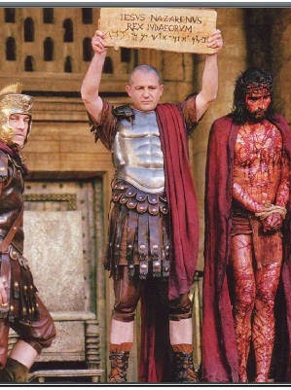
Our roles as Kings/Queens
Not political power/ruling over people
Jesus was not concerned with political power or impressed by it
Example: Pontius Pilate – Governor of Judah was frustrated with Jesus, “Will you not speak to me? Don’t you know I have the power to release you, and power to crucify you?”
Jesus didn’t care: “You would have no power over me unless it was given you from above.” (Jn. 19:11)

Slide 22
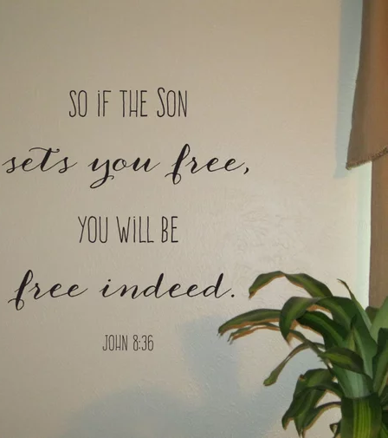
Our King/Queenship
Jesus wants us to have kingship over ourselves, our sin and Satan
When we do not master ourselves, sin, and Satan, we become slaves
It does not matter how much political power someone has
Jesus said, “Every one who commits sin is a slave to sin”
“If the son makes you free, you will be free indeed” (Jn 8:34-36)

Slide 23
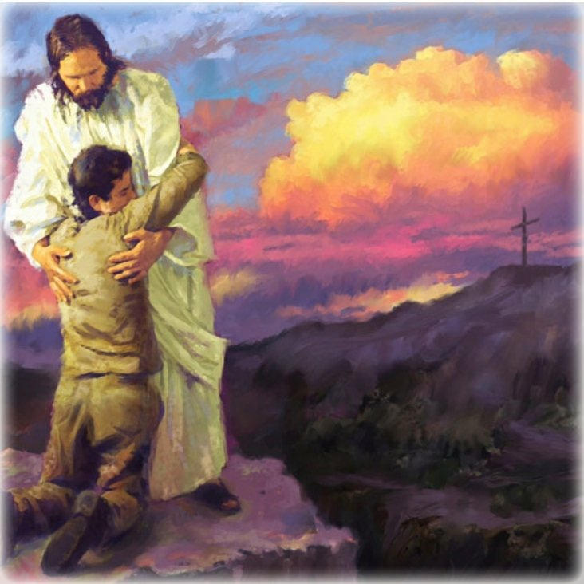
Our King/Queenship
Would Jesus have ever been awed by Napoleon, Stalin, or Hitler if he met them face to face?
Would he have considered them kings because of their power?
He would have seen them as slaves of their own lusts, especially their lust for power
No one starts to be a real king unless he starts to rule himself

Slide 24
Our Reign
Jesus came to give us that power and authority
We can then extend that reign over our own homes, jobs, families, friends, our entire lives

Slide 25
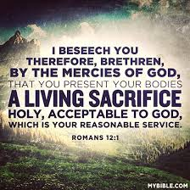
Our role as Priest
This flows from our role as being children of God
A priest offers sacrifices to God – think about the Mass
The sacrifice we offer to God is our own life
“I appeal to you...by the mercies of God, to present your bodies as a living sacrifice, holy and acceptable to God, which is your spiritual worship.” (Romans 12:1)
‘bodies’ = not just physical bodies, but our whole lives

Slide 26
Our role as Priest
The priestly self-sacrifice of our lives is acted out in every Mass
Laypeople bring up the ‘gifts’ (the bread and wine) to be blessed by the priest
Becomes the Body and Blood of Christ
We often ‘check out’ here
But it’s very important….

Slide 27
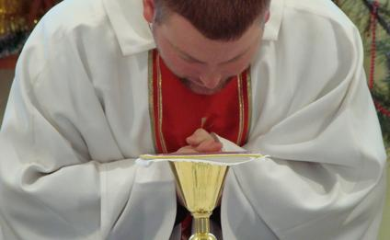
Our Role as Priest
The unblessed bread and wine represent the entire lives of all of us ‘laypeople’ or common priests
The ministerial priest takes the bread and wine – our very lives – and calls down the Holy Spirit so that it becomes the Body and Blood of Jesus
Our lives are united to Christ – our many small sacrifices to his great Sacrifice

Slide 28
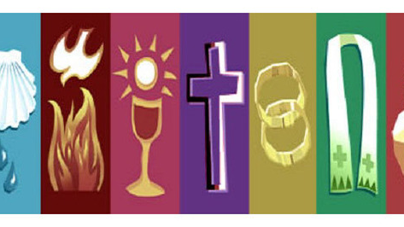
The ministerial priesthood & the common priesthood
This part of the Mass (the bringing up of the gifts) shows how we relate to each other as ministerial and common priests
We need each other
We need priests to give us the sacraments so that we have the grace and strength to fulfill our duty as priests – to offer our entire lives as a sacrifice to God for the salvation of the world
Our priests need us too:
Bread and wine wouldn’t be brought forward so Mass wouldn’t be celebrated
They couldn’t fulfill their calling without us
They would have nothing to do

Slide 29
Our role as Prophets
Through Baptism, God calls us to be prophets
We are called to speak God’s word to the world
This doesn’t mean we preach about or predict the future
Our job is to share God’s word and explain to others what God wants them to do
We do this more than we think – every time we share some of God’s truth with a friend, family member, co-worker, or stranger, we fulfill our call to be prophets

Slide 30
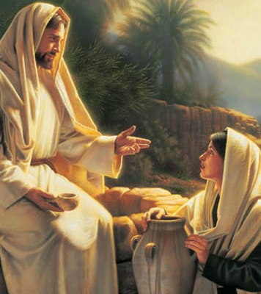
Our role as brides/bridegrooms
We are intended for a relationship with another person
We are not all necessarily called to be married
But we are all intended for a relationship (or communion) with another Person
Jesus Christ

Slide 31
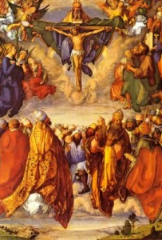
A glimpse of heaven…
A good and holy marriage gives us a glimpse of what heaven will be like
Our relationship with Christ in heaven will be better than the best marriage relationship on earth
“No eye has seen, nor ear heard, nor the heart of man conceived, what God has prepared for those who love him” (1 Cor. 2:9)
But this relationship doesn’t start in heaven, it starts now
If we can master our sins like we talked about before, we can begin to taste that communion with Jesus in this life

Slide 32
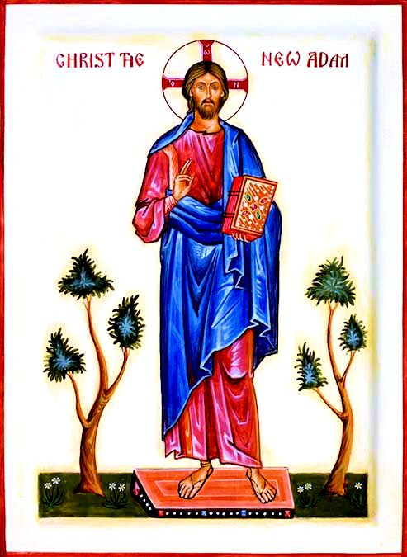
Our call
Our call is to live out these five roles of Adam, though we will never do it perfectly
Someone else already did – Jesus Christ
That’s why St. Paul calls him the “last Adam” and the “Second Man” (1 Corinthians 15:45-49)

