Slide 1
The Second Covenant with Noah

Slide 2
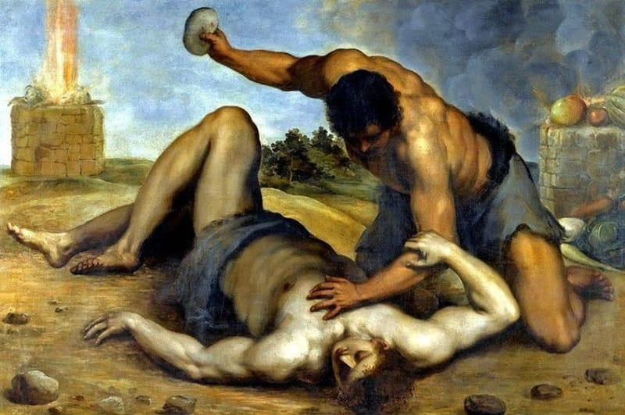
In between Adam and Noah….
Adam and Eve have 3 sons: Cain, Abel, and Seth
Cain murders his younger brother Abel
Cain starts populating the earth with his descendants
Most of his descendants are more wicked than he was

Slide 3
Polygamy begins
Many start marrying multiple wives at a time
God does not approve of polygamy
it’s difficult to properly parent all of the sons they were having
These wild children end up growing up and becoming a danger to other people and society

Slide 4
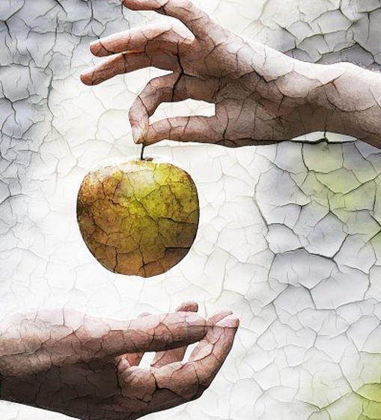
The problem
Adam’s descendants lost focus on this call to serve and love one another and God
This leads to seeking murder and pleasure alone in life and in their marriages
What happens when we lose our focus on serving God and others?
Notes:
When we lose our focus on giving of ourselves to others and God then our own relationships with God and other begin to come second to our own self-interest or selfishness

Slide 5
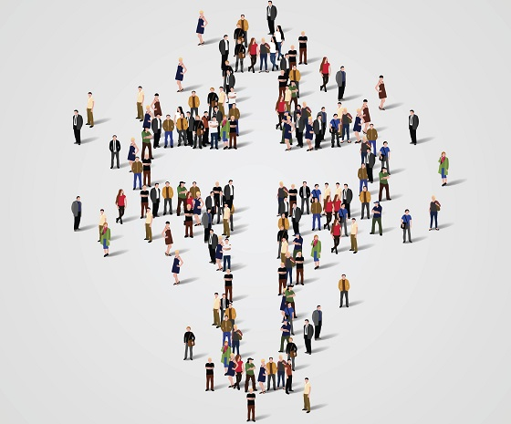
What can we do about it today?
There is a lot of selfishness invading our world in friendships, on social media, in marriages, in politics
We’re called to be an example by putting ourselves second
Always trying to focus on how we can help others in simple ways or in big ways
By serving others in our relationships rather than seeking our own self-interests

Slide 6
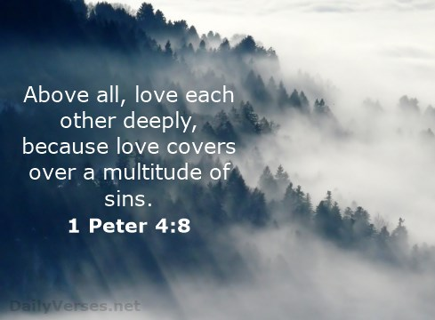
What can we do about it today?
Ask yourself: how can I use my gifts to build up the world?
When we do this – when we are so focused on giving ourselves to others – we don’t even have time to think about sin and selfishness because we are so focused on others
“Love covers a multitude of sins.” – 1 Peter 4:8

Slide 7
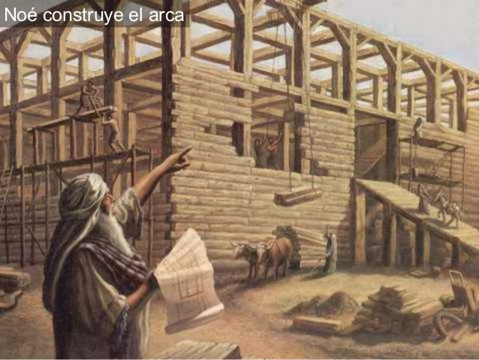
Starting over
Genesis 6:5: “The Lord saw that the wickedness of man was great in the earth, and that every imagination of the thought of his heart was only evil continually.”
God responds by backing up and starting over
The evil actions of Adam’s descendants provoke God to clean the earth with a flood and being again from scratch
Noah instructed to build and ark big enough to carry animals and his family and repopulate the earth

Slide 8
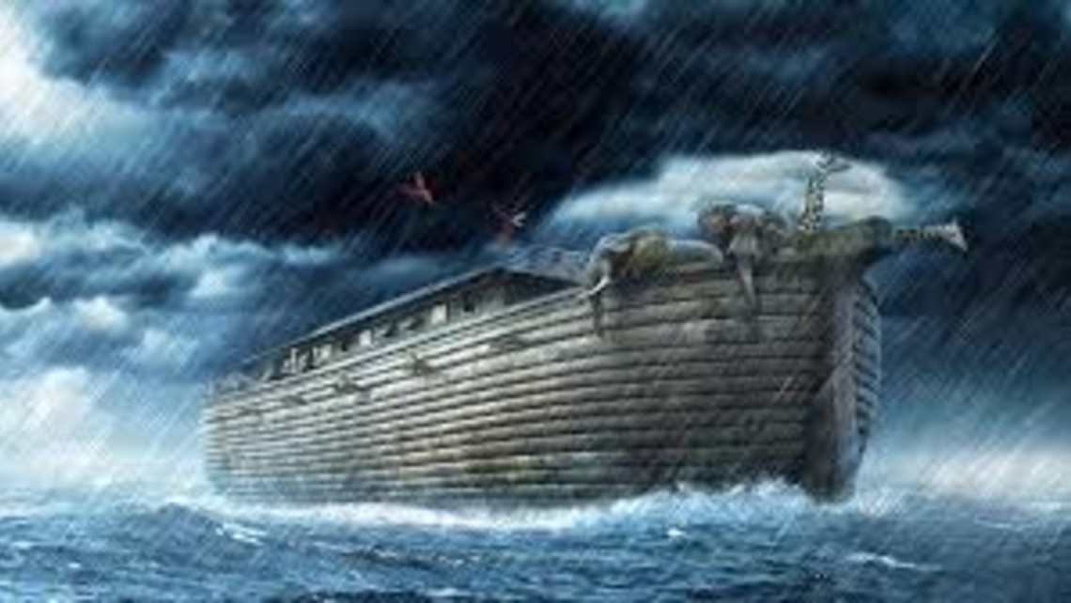
Starting over
He allows the world to return to a state of a formless void like it was before all of creation
“And the earth was without form or shape, with darkness over the abyss and a mighty wind sweeping over the waters” (Genesis 1:2)
“God remembered Noah and all the animals, wild and tame, that were with him in the ark. So God made a wind sweep over the earth, and the waters began to subside.” (Genesis 8:1)
For a second time God pulls the dry land out of the water in an act of re-creation

Slide 9
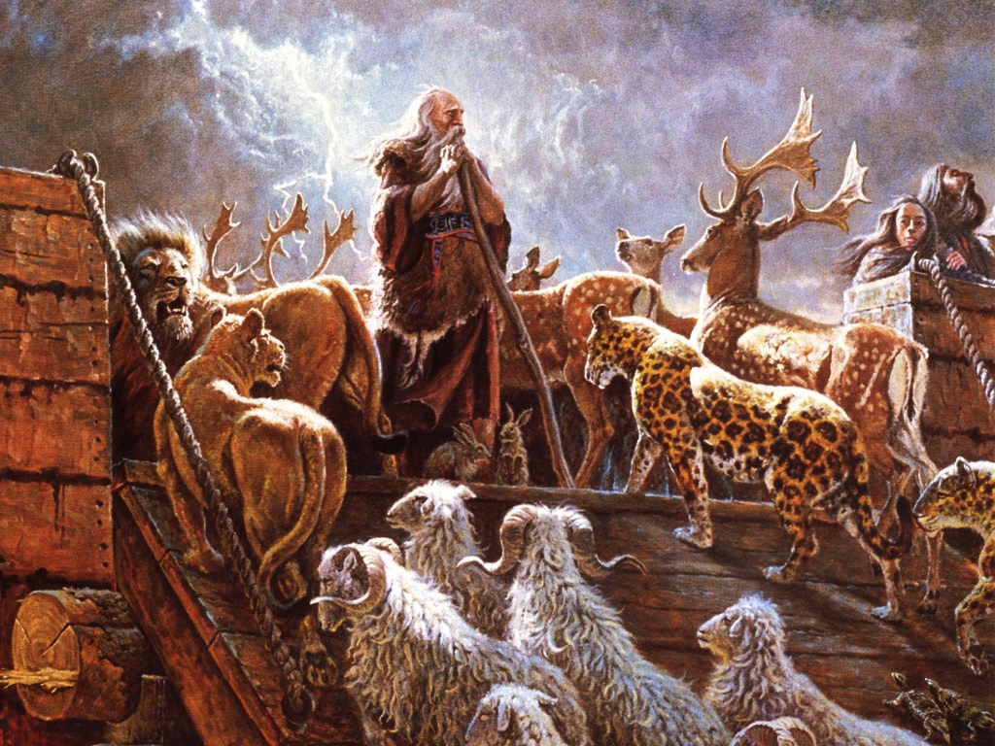
Noah: a preacher of righteousness
“He preserved Noah, a herald of righteousness, together with seven others, when he brought a flood upon the godless world.” (2 Peter 2:5)
Rebuked his peers for what they were doing while he was building the ark
No one paid any attention to the crazy man building the boat even though he was preaching and building a long time

Slide 10
Importance of number 7
Noah takes seven pairs of each clean animal
Seven pairs of each bird (one pair of each of the rest)
After 7 days of closing the door to the ark, the flood comes
In the 7th month of being on the ark in the flood, the ark comes to rest
When Noah sends a dove out and it comes back, he sends it out 7 days later
When the dove comes back with an olive leaf Noah sends it out again 7 days later

Slide 11
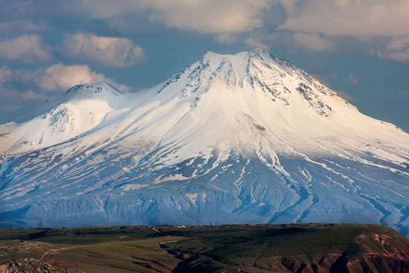
A new mountain
It rains for 40 days and nights
The flood plunges come to earth
The dry land reemerges 150 days later
Noah and his ark land on top of Mount Ararat, a new mountain of God (eastern Turkey)

Slide 12
Condition of world after flood
Noah sends out a raven from the ark
Then he sends out a dove
The dove returns
After 7 days, sends dove again
Comes back with olive leaf
Noah now knows waters had begun to go down
After 7 days sends dove again
Dove doesn’t come back
Noah releases passengers of the ark to repopulate the earth

Slide 13
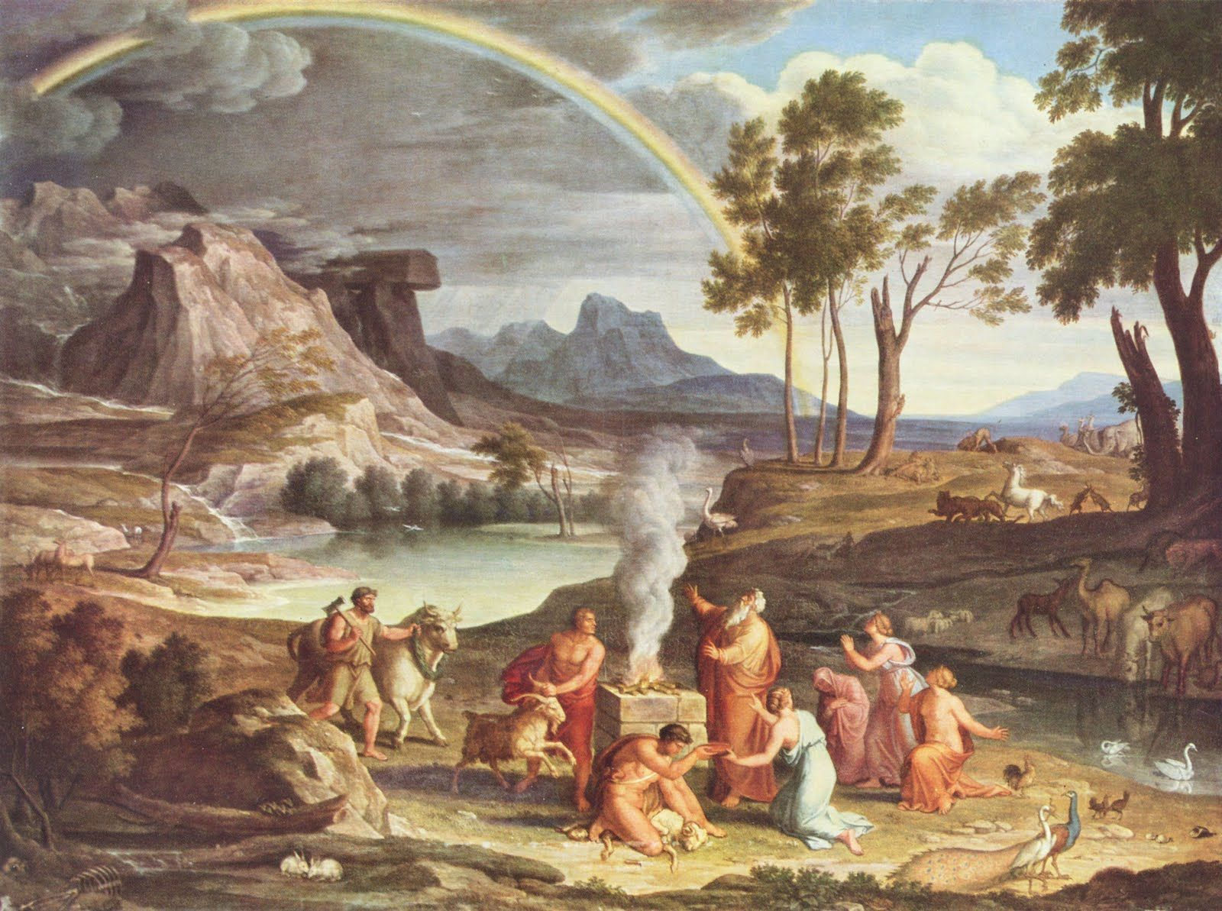
sacrifice to god
Noah emerges from the ark and performs a priestly act
He builds an altar and offers a sacrifice to God
God is moved with compassion for humanity and all creation

Slide 14
A new creation
Second creation story
Does flood eliminate sin?
No
But God knew we would sin again

Slide 15
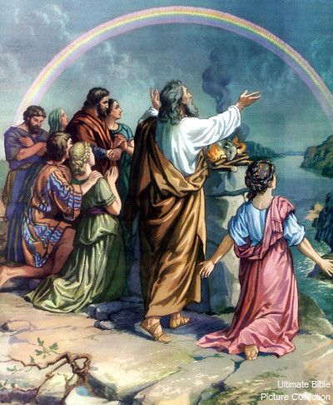
The second covenant
He makes a new covenant with Noah
God seals the covenant by making a sign in the sky: a rainbow
God gives the same commands to Noah as he did to Adam: “Be fruitful and multiply and fill the earth.”
This covenant is in a sense a renewal of the covenant with Adam
Only things aren’t quite as good anymore: there is now fear between man and animals

Slide 16
Similarities between covenant with noah and adam
“Be fruitful and multiply, and fill the earth”
God gives Noah dominion of the living things of the world
Inspired author uses literary parallelism to leave no doubt the flood begins a new creation

Slide 17
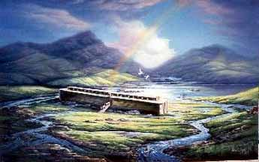
A new Adam, a new hope
Though it’s not as perfect as the covenant with Adam, Noah’s covenant brings us hope
Although the world is not perfect, humanity (which consists of Noah and his family at this point) is back in a relationship with God

Slide 18
Conditions to covenant with noah
God gives Noah and his family the earth and all its goods to have dominion over
Covenant is a two way street:
A blessing for abiding by its conditions
A curse for breaking it
God promises Noah he will never destroy the world again by a flood (covenant promise w/ Noah)
Sign: rainbow in the sky

Slide 19
The flood as a ‘type’ for baptism
“type” – symbolic precursor in history
When a Christian is baptized our old world of sin is washed away, and we are created anew, reborn in the waters of baptism
We still carry the potential to sin
But we receive God’s blessing and promise that he will not destroy us

Slide 20
What we can learn from Noah & the flood

Slide 21
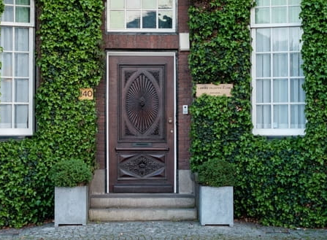
1. There is one door through which we can be saved
God told Noah to build one door on the vessel. (Gen. 6:16)
That one door led to him and his whole family being saved from destruction.
There is only one door through which we too are offered salvation – through Christ alone.

Slide 22
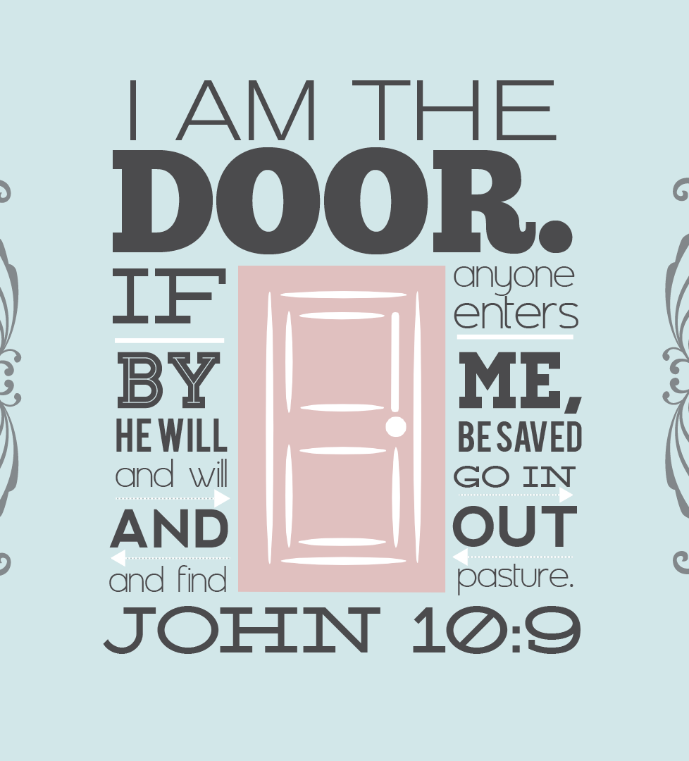
The one door
Noah was not a perfect man, but the Lord saw his heart and faith and saved him
Jesus said, “I am the door. If anyone enters by me, he will be saved,” John 10:9.
Noah had a choice to make that day, and we too are given a choice, of whether we will walk through that door of rescue.

Slide 23
2. God remembered Noah, so also he remembers us
For 40 days and nights the rain pelted down; water covered the earth, and all was destroyed.
The number 40 is meaningful – where else is it used in the Bible?
40 = completion

Slide 24
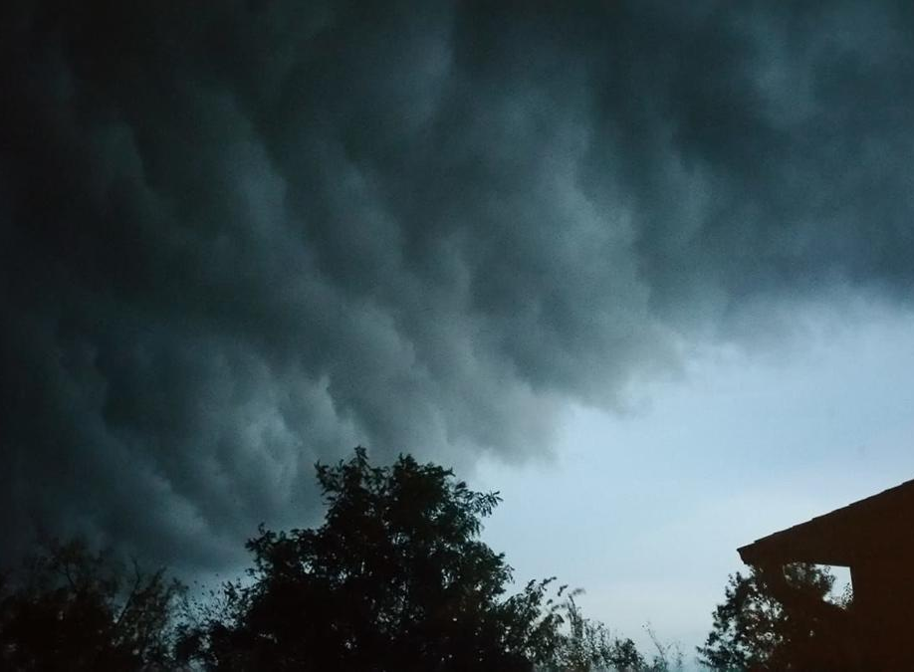
“And surely I am with you always, to the very end of the age,” Matthew 28:20.
There are many storms in life – God doesn’t always take them away
But He does promise this: He is with us, and He remembers us, always.
Jesus’ last words on this earth before ascending into heaven were these: “And surely I am with you always, to the very end of the age,” Matthew 28:20.

Slide 25
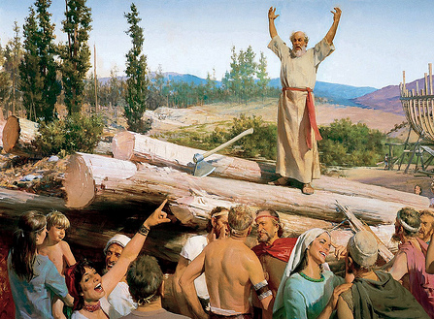
3. Noah reminds us of the importance of faith
It is by faith that we are saved
Noah was willing to stand apart from the rest of the world by living out his faith and doing what God had asked of him
If he didn’t have faith in God, he wouldn’t have built the ark and been saved
Noah’s life of faith in God shows us the necessity of placing our faith, not in our own selves or in this world

Slide 26
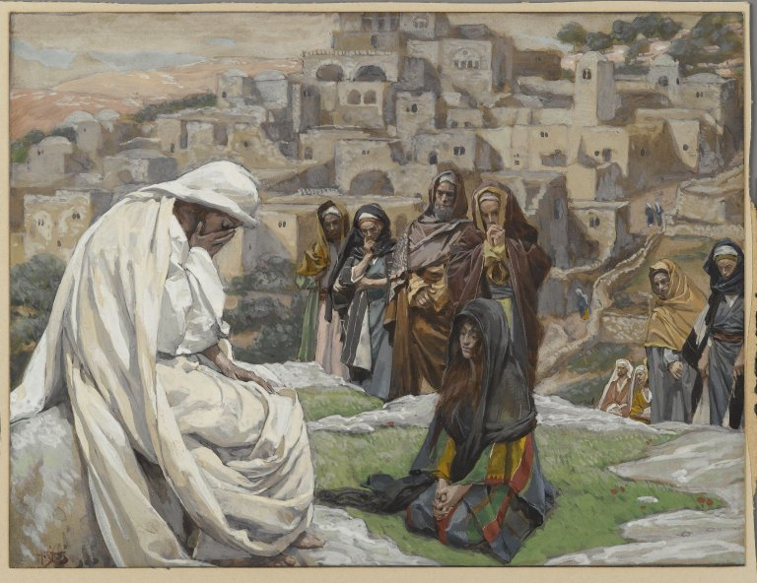
4. God desires for no one to perish
God didn’t just destroy the earth with a flood in a moment of anger and judgment over wickedness.
The Bible 120 years between the warning of the flood and the flood actually coming down
the ark took him many years to build as well.
Notes:
Think about how long God is giving us until the second coming of Christ to turn our faith to him

Slide 27
4. God desires for no one to perish
The point is that God gave time for people to repent and return to Him.
He even gave the visible reminder through Noah’s work on the ark
Noah must have been ridiculed through those years. The ark was not even built near water or an ocean, which must have seemed even more ridiculous to those watching.
Even so, Noah stayed strong and was obedient to completing the task.
Standing alone on the promises of God was not, and is still not, an easy thing to do. Yet it reaped great reward and blessing, not just for him, but for his entire family.

Slide 28
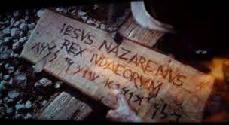
5. God made a covenant & he is forever faithful to his promises
After the storm, there was hope and promises for blessings. That's still true today.
Every time we see a rainbow after a huge storm, we can be reminded of God’s promise to bring good out of what seems hard
“Whenever the rainbow appears in the clouds, I will see it and remember the everlasting covenant between God and all living creatures of every kind on the earth,” Genesis 9:13,16.

Slide 29
God is faithful to his promises
The olive tree branch brought back by a dove signifies the Holy Spirit, which descended on Jesus at the time of His baptism by John the Baptist.
The olive branch is a symbol for peace. Jesus is our peace, and through Him, we have the peace that passes all of our own understanding because of the grace of Christ over our lives.
Interestingly, the sign hung on the cross of our Savior is believed to have been made of olive wood.

Slide 30
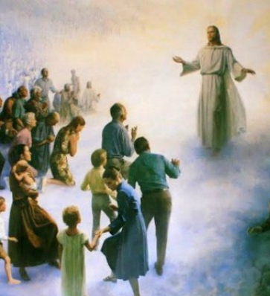
6. Jesus will come again, but we do not know the day or the hour
The Bible is very clear in relating the events of Noah’s day with the days before Christ comes again.
People were busy doing their thing and were totally unaware of their need for God and eternal destiny.
They were not ready. They were surprised even though the warnings had been given.

Slide 31
Jesus will come again
“But as the days of Noah were, so also will the coming of the Son of Man be. For as in the days before the flood, they were eating and drinking, marrying and giving in marriage, until the day that Noah entered the ark, and did not know until the flood came and took them all away, so also will the coming of the Son of Man be,” Matthew 24:37–39
Though we can never know the day or hour of Christ’s return, we can choose to make every day count. We can live with an eternal perspective and always live ready, always be aware.
“So you also must be ready, because the Son of Man will come at an hour when you do not expect him,” Matthew 24:44.

Slide 32
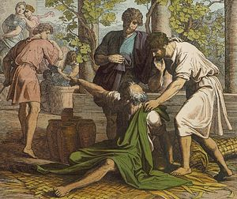
The fall of Noah
In Genesis 9, we read about a fall of Noah that closely resembles that of Adam
Noah drinks wine and gets drunk and naked in his tent
His son Ham goes into the tent, sees Noah, and makes fun of him to his brothers
Noah’s other two sons go in backwards and cover their father’s nakedness
When Noah wakes up, he realizes he has been violated and curses Ham’s son, Canaan

Slide 33
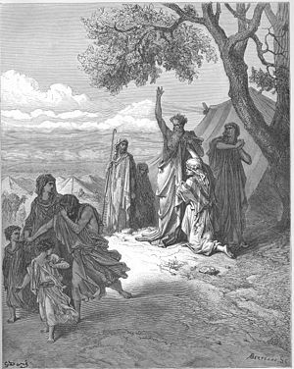
What’s going on?
Second, the themes of this story are ones we have seen before:
The consumption of fruit
Nakedness
Shame
Curse
Noah’s story is the fall of the New Adam

Slide 34
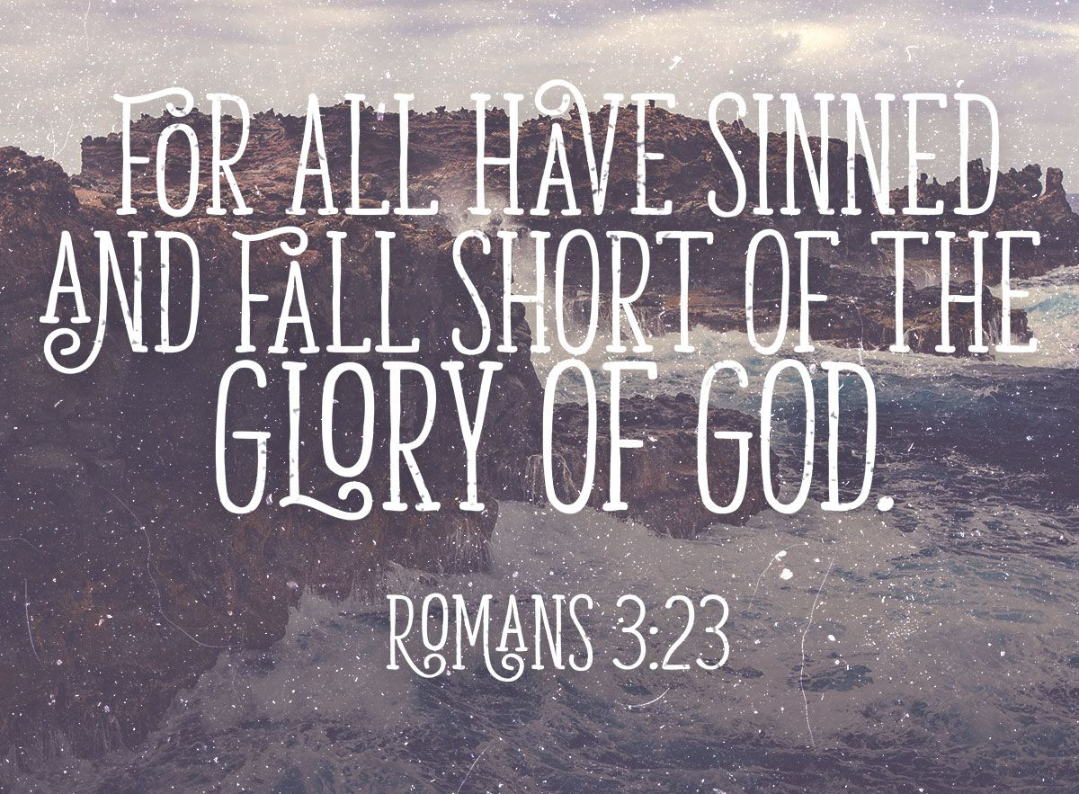
Right away we see that the flood did not solve all of the problems of humanity
Descendants of Adam still carry original sin
All the “bad people” have been washed away
But the problem is that the line of good and bad does not run cleanly between groups of people
It runs down the center of each person

Slide 35
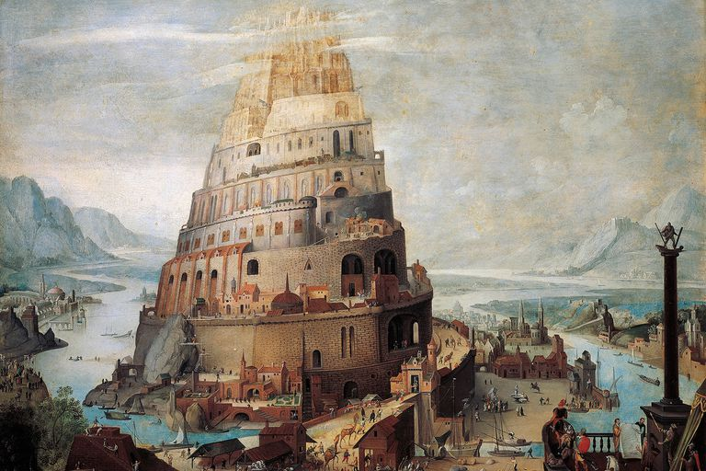
The tower of babel
The people decided to build a tall, proud symbol of how great they had made their nation.
The Babylonians wanted a tower or man-made mountain that would "reach to the heavens" so that they could be like God and that they would not need Him.
God sees the pride and arrogance in the hearts of the people

Slide 36
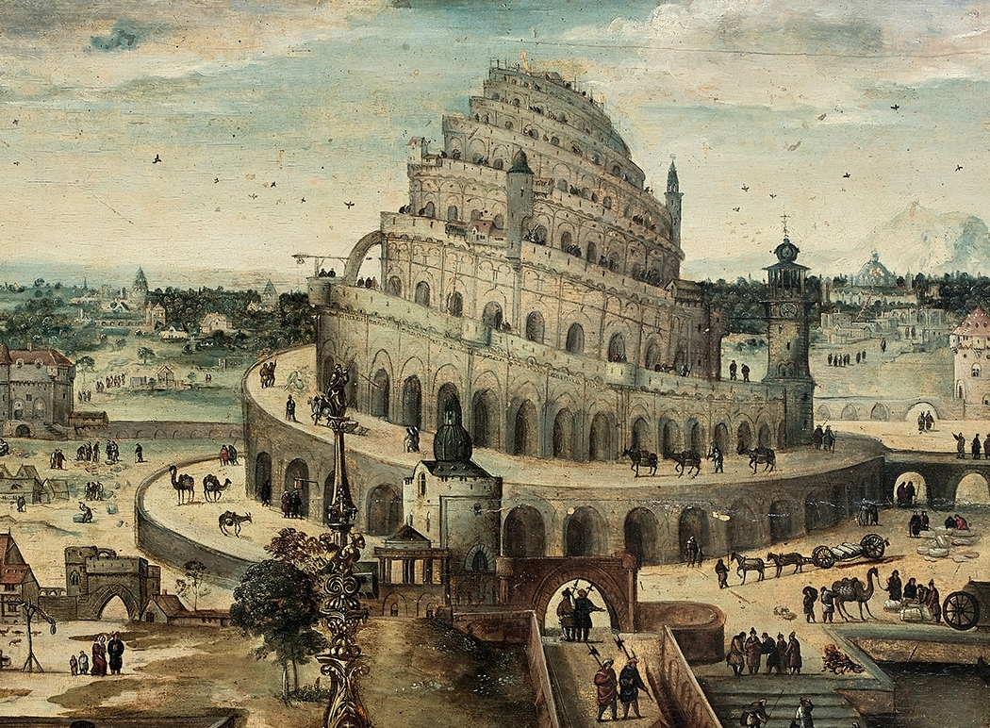
The tower of babel
So he caused the people to suddenly speak different languages so they could not communicate and work together to build the tower.
This caused the people to scatter across the land.
Babel = confusion.
This story is a powerful reminder of how important it is to obey God's Word and to not think that we can build a successful but godless life on our own
Notes:
Undone at Pentecost – all can understand each other through the holy spirit – we need god in our relationships, to understand one another, to be one, to reach God

