Slide 1
Abraham: our father in faith
The third covenant

Slide 2
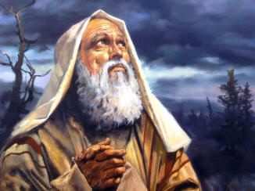
Present state
Humanity is scattered across the earth in disharmony
The family relationship with God has been broken
The situation needs to be fixed
God makes a decision that will alter history forever

Slide 3
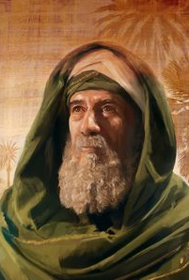
Abram
From present-day Iraq, a “Chaldean”
Mission: to bring back God’s blessing to the human family
The threefold promise:
The LORD said to Abram: Go forth from your land, your relatives, and from your father’s house to a land that I will show you. I will make of you a great nation, and I will bless you; I will make your name great, so that you will be a blessing. I will bless those who bless you and curse those who curse you. All the families of the earth will find blessing in you.
Notes:
notice… Abraham is not chosen for his own sake but he is chosen for others – so that he can bless the rest of humanity
“you will be a blessing” “in you all the families of the earth shall be blessed.” a big deal
“all families of the earth” – bible refers to Genesis 10 – a list of the 70 ethnic groups that make up humanity from the ancient Israelite perspective

Slide 4
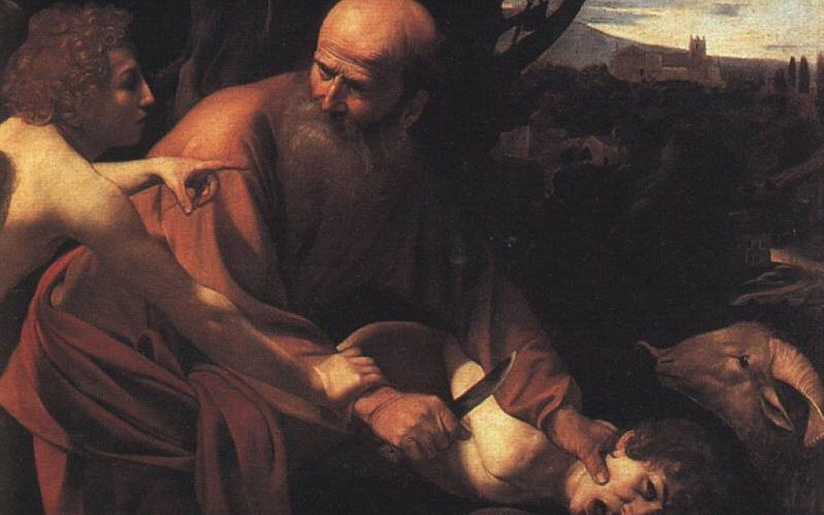
The old testament
It is a book about salvation and blessing for all human beings
Many think the OT is a Jewish book about salvation for the Jews alone
But the whole reason the Jews are special is because their ancestor Abram was chosen by God to bring blessing to everyone

Slide 5
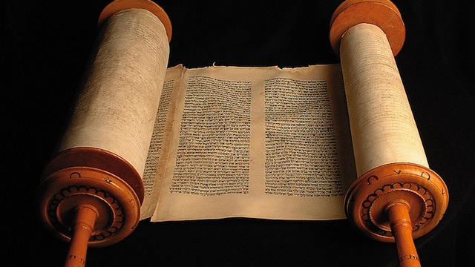
Who is Abram?
Introduced out of the blue
Descendant of Shem
Living in modern day Iraq with his family
God appears to him and speaks to him
We’re not sure why God likes him but there must be some story not in the Bible
Notes:
In Gen 10, the bible lists all nations on earth
Gen 11 0 how they lost God’s favor
Gen 12 – shows how they will get it back -- Abraham

Slide 6
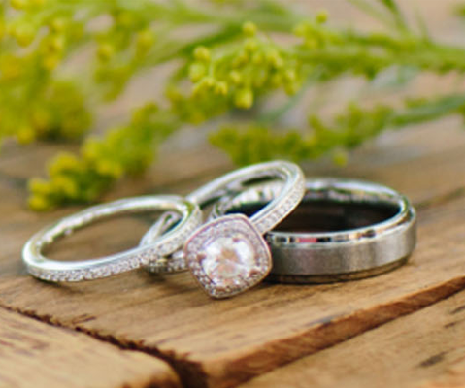
The three promises
Great Name
Great Nation
Great Blessing
Simple promises → formal covenants
Promises – engagement ring
Covenant – Wedding ring
Engagement ring – strong hope, firm intention
Wedding ring – unbreakable commitment

Slide 7
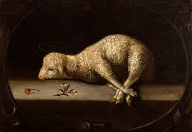
The first promise/Covenant: Genesis 15
God comes and speaks to Abram to offer him some encouragement
Abram is upset because he doesn’t have any children even though God has promised him them
God tells him not to worry about it – it will happen in time
Abram wants more reassurance
God tells him to bring a bunch of animals, lay them out, and cut them all in half

Slide 8
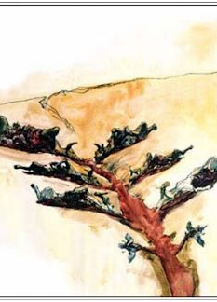
“Covenant between the pieces”
Everything gets dark
A torch and firepot appear and move between animal pieces as God speaks to Abram
Ancient readers would have recognized this ritual as a covenant-making ceremony
“The covenant between the pieces”

Slide 9
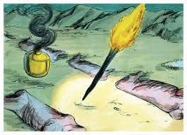
What does it all mean?
“If I do not keep my covenant commitments, may I be killed like these animals.”
It was like calling down a curse of death on yourself if you didn’t do what was promised
Torch and firepot = God’ presence
God: “If I don’t keep my word to you, Abram, may I be cut to pieces just like these animals.”

Slide 10
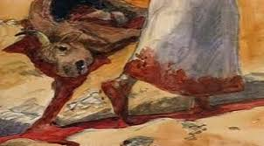
How can god call a curse on himself?
What God is doing is coming down to a human level
He takes part in something that Abram would understand as a human
Divine Condescension
Covenant makes them a family
Animal sacrifice video:
https://thebibleproject.com/blog/animal-sacrifice-really/

Slide 11
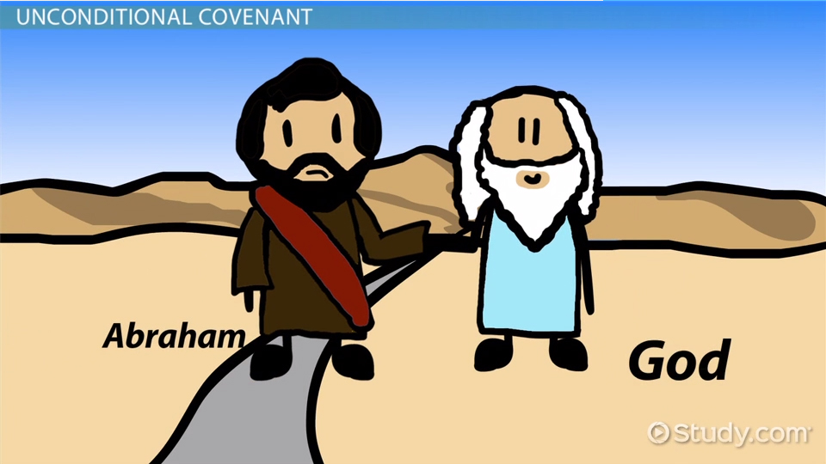
How covenants work
Most have special rules, promises or instructions attached
These would show how the new family would be run
Verses 4-5, 15-16, 18-21 – God gives some special promises
Abram will have lots of descendants
They will possess a lot of land

Slide 12
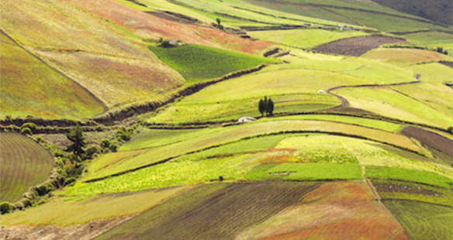
Land & people
Lots of people + lots of land = A GREAT NATION
So, the first promise (a great nation) has been worked into a covenant with God

Slide 13
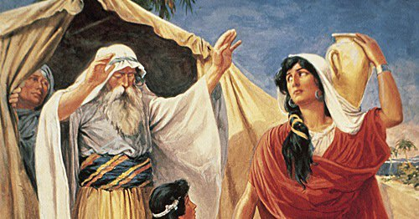
The (MINI) fall of Abram ~ Genesis 16
Abram and Sarai start to doubt God’s plan to give them children
They wonder if it will work in ‘normal’ way
They decide to ‘help God’ (or take matters into their own hands)
Abram listens to his wife’s bad idea (think of Adam and Eve)
He sleeps with Sarai’s maid, Hagar
Takes her as a second wife and surrogate mother
According to legal customs in those days, the maid’s children would belong to her mistress

Slide 14
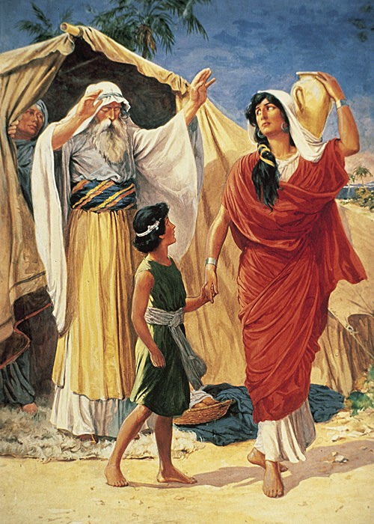
consequences
The plan “works” – a son is born
But he is not the person God intended to be Abram’s heir
This causes arguing, fighting, envy, and unhappiness in the family
Almost every time someone tries to take more than one wife in the Bible, it leads to trouble
It’s trying to teach a lesson: stick with one spouse

Slide 15
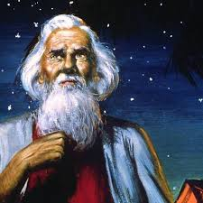
The covenant renewed
God has to intervene and clean things up since things have gotten so bad
God repeats his promise of a great nation and adds to it
He promises for the first time that kings will come from Abram and that Abram will be the father of many nations
This is related to the promise of a ‘great name’ (Gen. 12)

Slide 16
“GREAT NAME”
Ancient times ‘great name’ was connected to kings
Ancient kings were ones thought to have great names
Also known as ‘fathers’ of their country

Slide 17
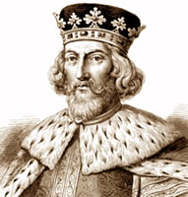
The father of many nations
Emperors who ruled over MANY nationalities and ethnicities were “fathers of many nations”
The promise that Abram would become the father of many nations points to the same reality
Abram’s descendants would include great kings with great names
They would become emperors and fathers of many nations
So the promises to Abraham would be seen in his descendants

Slide 18
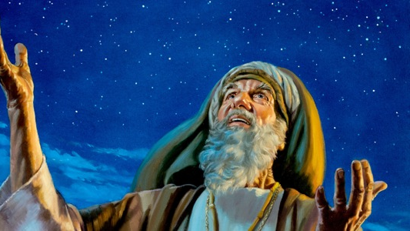
From Abram to Abraham
To highlight the connection with the promise of a great name, God actually gives Abram a new name – Abraham
He also gives him a ‘covenant duty’ – circumcision
Why would God make Abraham do this?

Slide 19
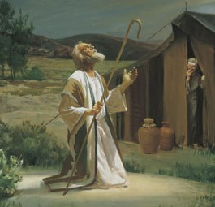
Stage 2 of the covenant
Possibly because of how Abraham went astray with Hagar
It may be a symbolic rebuke of what Abraham did
Another possibility…Abraham is symbolizing that “If I don’t keep my covenant duties may I be cut off (or killed) like this piece of flesh”
In Gen. 15 Abram cuts animals, but in Gen. 17 Abram cuts himself
The things Abraham has to do for the covenant are becoming more serious

Slide 20
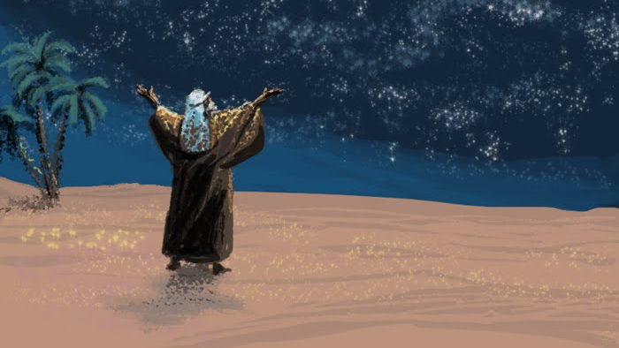
Stage 2 of the covenant
In many covenant-making ceremonies for the Israelites they would always cut something to symbolize the promise made
Cutting produced blood which meant:
Two covenant parties now shared one blood – they were family
If one of the parties broke the covenant they promised that their blood would be shed

Slide 21
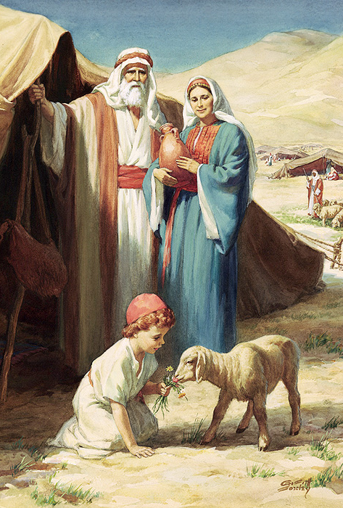
Genesis 17
The last thing God does in Gen. 17 is clear up who is going to be the covenant heir
God makes it clear that Ishmael (Hagar’s son) will be blessed but will not receive the covenant blessing because he did not come from Sarah, who was supposed to be Abraham’s ONE wife
Soon Isaac will be born and Hagar and Ishmael will be disinherited but taken care of by God

Slide 22
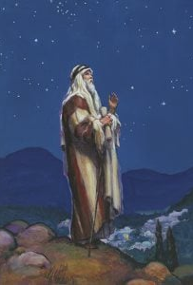
The final covenant with Abraham
By the end of Gen. 21 things seem to be working out well for Abraham
The promises of a great name and nation have been worked into the covenant
But the last and best promise of the universal blessing to the whole human family hasn’t been mentioned since Gen. 12:3

Slide 23
God tests Abraham
The answer comes in Genesis 22
But first God wants to see if Abraham and Isaac are the right people to bring blessing into the rest of humanity
He tells Abraham to take his “only son” Isaac to Mt. Moriah and offer him as a sacrifice

Slide 24
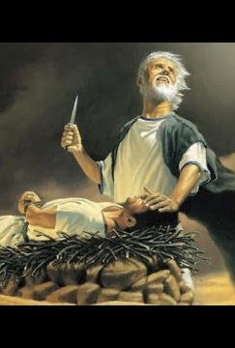
The sacrifice of Isaac
Abraham and Isaac start on the journey, reach the mountain, and Isaac is laid on the altar
How can a good and loving God command Abraham to kill his own son?
Most people think of an old man overpowering his little son and tossing him onto an altar to kill him
We have to read the text very carefully

Slide 25
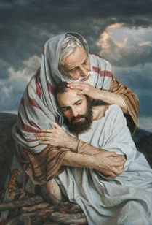
What really happened
First, who carries the wood up the mountain for the sacrifice?
Clearly, Isaac is the stronger of the two because all of the wood needed for a sacrifice would have been very heavy
Abraham only carries the fire and the knife
So we shouldn’t see an old man and a child, but an old man and a strapping teenager or young man

Slide 26
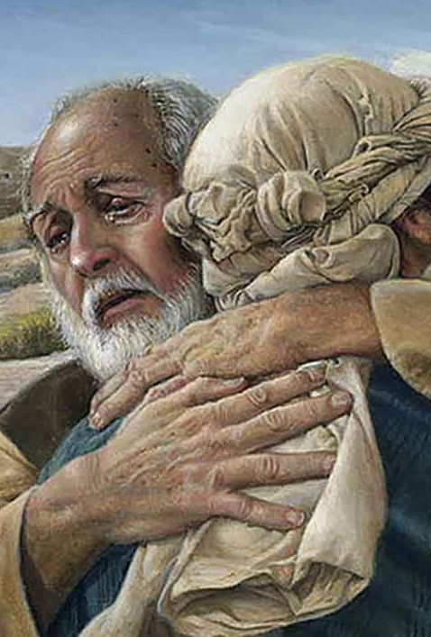
Isaac’s cooperation
So when Abraham later binds Isaac and places him on the altar, we can be sure that Isaac has fully cooperated
it was a “death freely accepted” that he “entered willingly”
Fast-forward to Christ’s death….

Slide 27
The sacrifice of Christ, the one and only son
Where else in the Bible do we see a “one and only” son carrying the word of his own sacrifice up a hill to be sacrificed by his father to God?
Calvary – Jesus
The sacrifice of Isaac on a mountain in Gen. 22 is a premonition of Christ’s sacrifice on the cross
Genesis 22 is the Calvary of the Old Testament

Slide 28
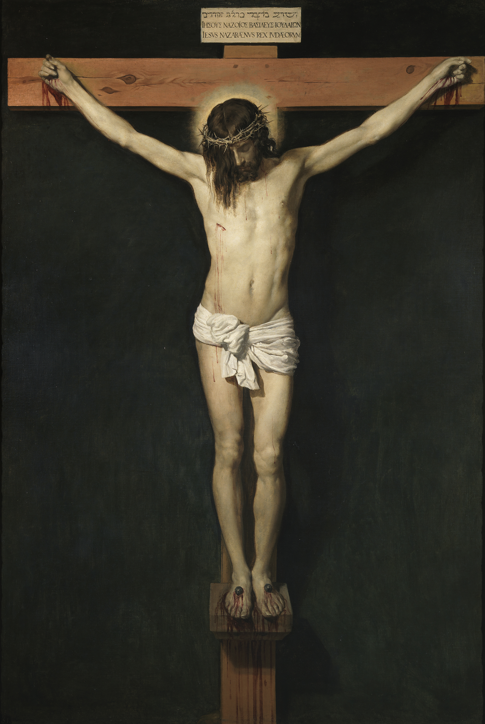
Jesus, the new Isaac
When the Bible says “one and only” in Hebrew, it is used VERY rarely
It is used three times in Gen. 22 to describe Isaac and in the Gospel of John to describe Jesus
St. John wants to show us in Jn. 3:16 that Jesus is a new Isaac
He is of course much greater than Isaac because he goes through with the sacrifice and actually dies

Slide 29
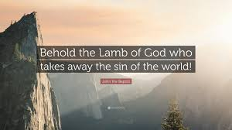
The lamb of God
Jesus dies on the cross because he is “the Lamb of God who takes away the sins of the world”
Abraham hints at this when they are walking up the mountain
Isaac asks him, “behold, the fire and the wood; but where is the lamb for a burnt offering?”
Abraham replies, “God will provide himself the lamb for a burnt offering, my son” (Gen. 22:8).

Slide 30
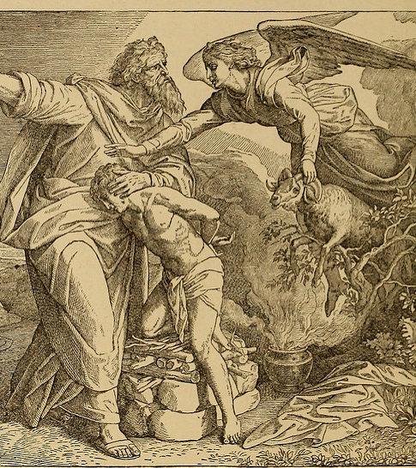
God provides the sacrifice
Of course this does happen when the angel stops Abraham from sacrificing Isaac and a ram appears as a substitute in the bushes
The deeper sense of the story will be fulfilled almost at the same spot two thousand years later
when Abraham’s descendant, Jesus of Nazareth, will be laid on the wood and slain as the true Lamb of God

Slide 31
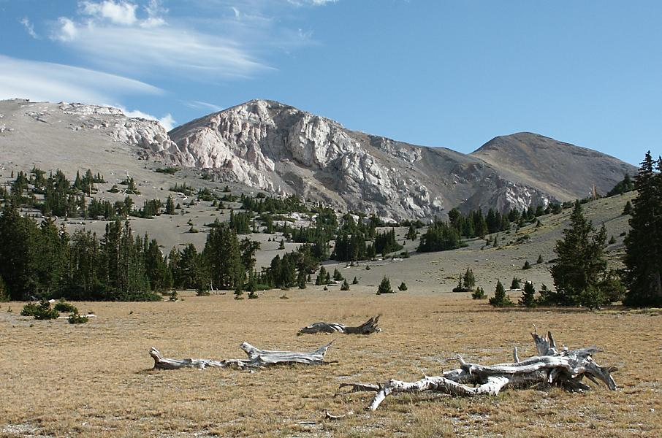
The location
Isaac was almost sacrificed on Mount Moriah
This is the location that King Solomon will later choose to build the temple which was within sight of Calvary near the hill where Jesus made his self-sacrifice

Slide 32
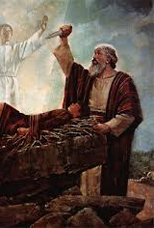
Not a story about child abuse
God invited Abraham and Isaac to take part in the very kind of sacrifice that God the Holy Trinity would have to undergo so many years later in order to save humanity from sin and death
Basically, God was saying to Abraham and Isaac, “Are you willing to undergo the kind of sacrifice I will have to undergo in order to restore blessing to all humanity?”
As a father, are you willing to part with your only son?
Isaac, are you as a son willing to die in obedience to your father out of love for God?
Isaac and Abraham clearly show by walking up the mountain “we are”

Slide 33
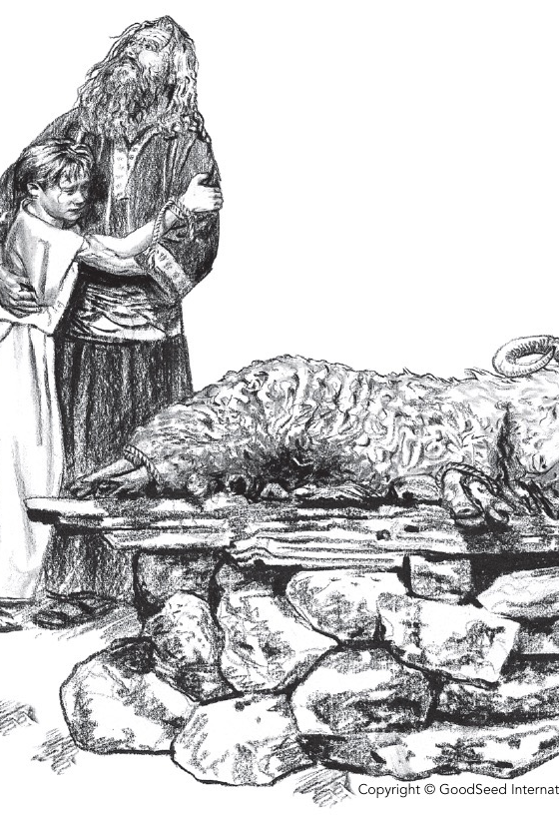
God’s compassion
This is why God is so moved by their willingness
He’s so moved that he does something for Abraham that he has only done for a handful of people in all of human history
He swears an oath to Abraham – he promises to multiply his descendants as numerous as the stars in the heavens and the sands on the seashore

Slide 34
God’s promise
“and your seed shall posses the gate of his enemies, and by your seed shall all the nations of the earth be blessed, because you have obeyed my voice.”
“seed” can mean “child” or “children” – you can plant one seed or many
The ‘seed’ in this passage could be either all of Abraham’s descendants OR ONE particular descendant
The greatest blessing of the world that all people will receive is Jesus Christ, the ‘seed’ of Abraham, his descendant

